Slide 1
LEC -9
PHYSICAL LAYER:
(Basics for Data Communications, Analog , Digital signals and Signal & Media)

Slide 2
What is Basic of DATA COMMUNICATIONS ?
The term telecommunication means communication at a distance. The word data refers to information presented in whatever form is agreed upon by the parties creating and using the data.
The basic of data communications is based on the transmission of this digital data between two or more computers and a computer network or data network is a telecommunications network that allows computers to exchange data.
Data communications are the exchange of data between two devices via some form of transmission medium such as a wire cable or may be wireless.

Slide 3
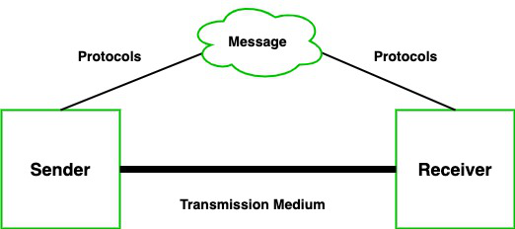
How data is transmitted in data communication?

Slide 4
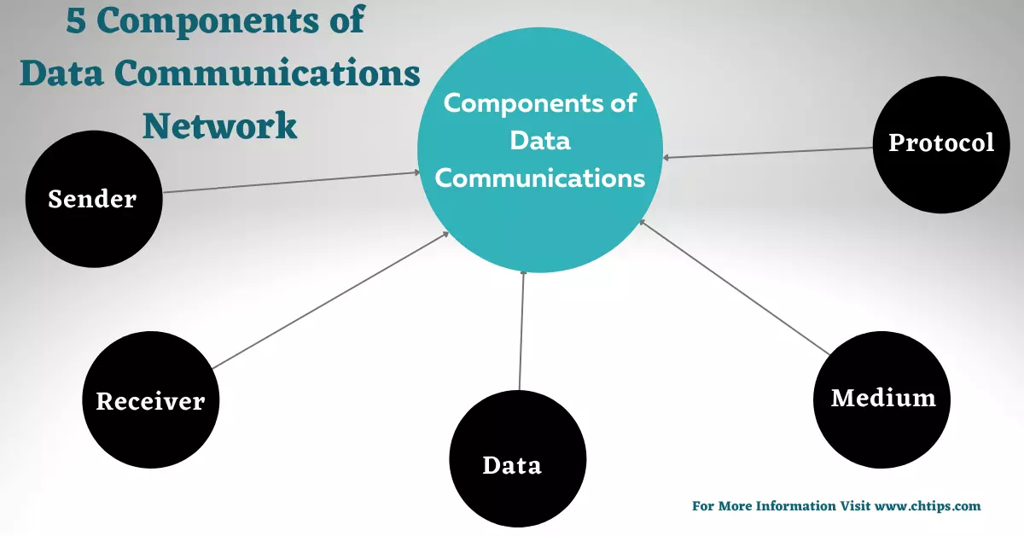
What are components of Data Communication ?

Slide 5
How Components is used in Data Communication ?

Slide 6
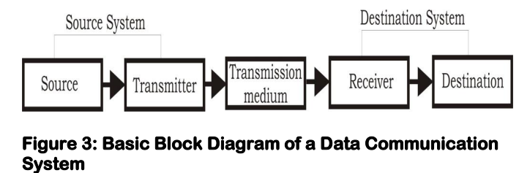
Block Diagram of data communication system .

Slide 7
Function of components in data communication .
1. Sender –The main function of Sender device is that sends some data or can say messages to the receiver. The message which the sender device can be in any form like text messages, audio messages, video messages, photos, documents messages, etc.
It is also known as a source, transmitter, or node.
2. Receiver- The receiver is a type of device which is used to receive message from the sender . The sender device location is typically different from the receiver device location.
3. Message – The data which is send by the sender to the receiver is known as Message.
4. Transmission Medium-When the sender sends the messages to the receiver, there is a path or can say medium to travel the data to the receiver. These mediums can be a wired path or a wireless path. A wired path like coaxial cable, fiber-optic cables, etc., and a wireless path like radio waves and laser, etc.
5. Protocol- Protocol is basically a set of rules that defines how the data will be transmitted between the devices.

Slide 8
Types of Data Communication .
Half-Duplex Communication -In this types of communication, a sender can able to send the data or message to the receivers and also the receivers receives the data but not at the same time. It is called two-way communication or bidirectional communication. Example: walkie-talkie
Full-Duplex Communication - It is exactly same as half-duplex communication but in this the sender send the data or message to the receivers and also the receivers receives the data at the same time. It is also known as two-way communication or bidirectional communication. Example: Telephones lines and mobile phones etc.
Simplex Communication - In this type of communication, data or message can be sent only in a one direction or can say uni-directional communication in which the one device only receives data and another device only transmits data, and each device uses its entire transmission capacity. Example: Keyboard, Monitor, Loud Speaker etc.

Slide 9
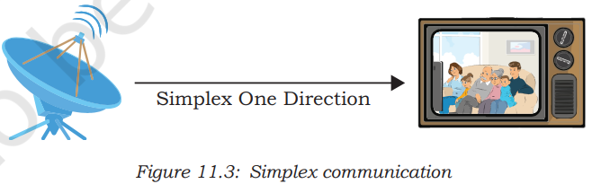
Simplex data communication .

Slide 10
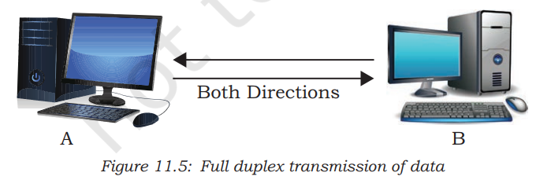
Communication perform in Full duplex.

Slide 11
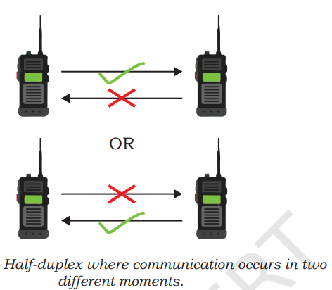
Communication occurs in two moments .

Slide 12
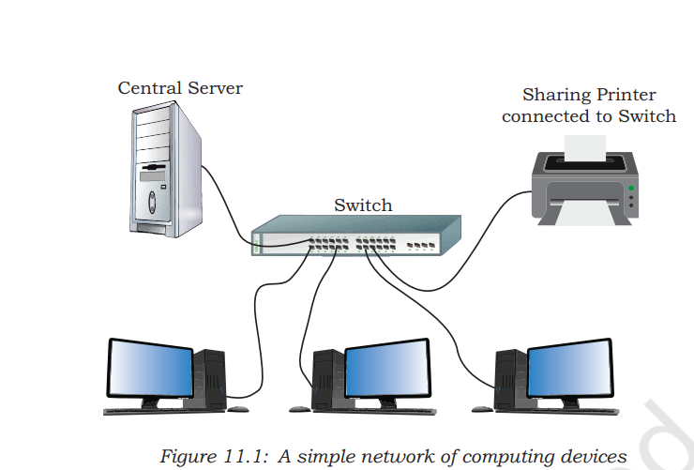
Example of Simple network with computing devices .

Slide 13
Characteristics of Data Communication.
There are four characteristics of data communication are:
Delivery.
Accuracy.
Timeliness.
Jitter.
Delivery- In the data communication, System must be deliver the data to the correct destination. It is known as Delivery .
Accuracy - At the time of delivering the data to its destination it must transferred accurately without getting any error. Sometimes the data may be corrupted during the transmitting which affects the accuracy level of transferring the data.
Timeliness -In the data communication, timeliness means the data must deliver on time without getting any delay, Late delivered data is useless It is known as “Timliness”.
Jitter - It refers to the difference in packet arrival time. It is caused by an uneven delay in the delivery of audio or video packets.

Slide 14
What is difference between Analog and digital signals ?
Analog and digital signals are the types of signals which are used for carrying information.
Signal is defined as Information converted into an electrical form suitable for transmission is called a signal .
The major difference between both types of signals –
Analog signals- The analog signal is a continuous signal in which information is encoded as the continuous variable and in analog signals have using the continuous electrical signals.
Digital signals – The digital signal is also type of signal which are not continuous, but signals are discrete in value and time. These signals are represented by binary numbers and consist of different voltage values. Digital signals have non-continuous electrical signals.

Slide 15
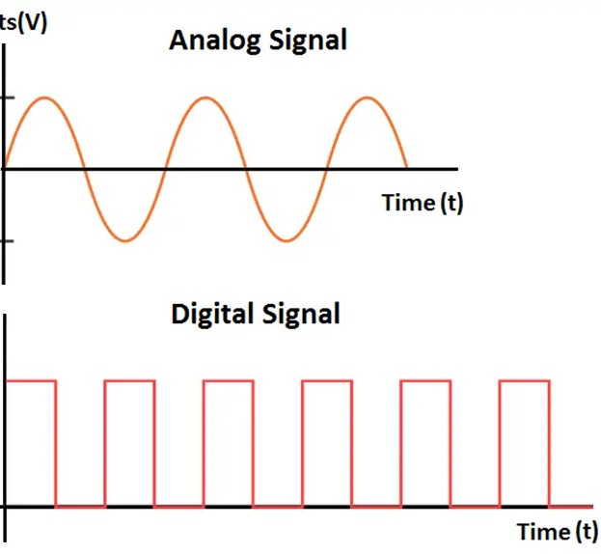
Diagram of Analog and Digital signals.

Slide 16
Difference between Bandwidth and Data Rate.
Bandwidth: - It is defined as the width of the spectrum. Network bandwidth is used to measure the data transfer rate or capacity of a given network.
Question:- A given signal has frequencies of 3125 MHz, 635 MHz, 2000MHz and 7000Mhz. Determine the bandwidth of the signal?
Answer: - The bandwidth of a signal is the difference between the highest and the lowest frequencies. For the given system the bandwidth is 7000 – 635 = 6365MHz. Therefore the bandwidth of the signal is 6365MHz.
Data Rate: - Data Rate is defined as the amount of data transmitted during a specified time period over a network. It is the speed at which data is transferred from one device to another or between a peripheral device and the computer.
Data Rate: Data Rate is defined as the amount of data transmitted

Slide 17


